Slide 1
Screens flow
Conditional screens flow

Slide 2
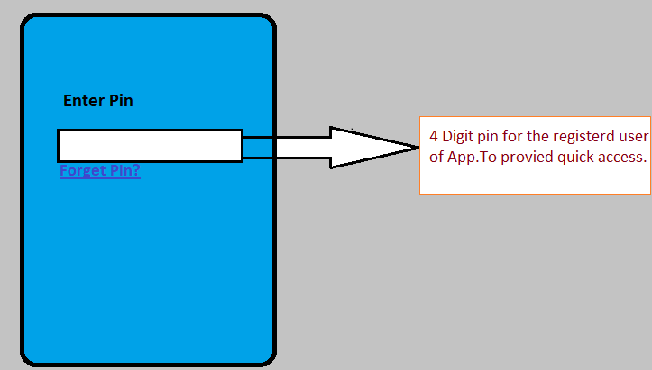
On App Click
If User is already logged in and set the Pin to access the app.

